Slide 1
COVID-19 Antibody Tests
Allison Lindman, MD
May 5, 2020

Slide 2
Disclosures and Disclaimer
No relevant financial interests
Content and opinions are the author’s and do not necessarily represent those of Jemez Springs Library administration, the municipality of Jemez Springs, or any other entity.
This presentation is based on the information currently available. Recommendations may change as we gain more knowledge.
Most of the reports on this topic are anecdotal or “pre-print” and have not been reviewed by experts in the field.

Slide 3
Overview
Immunology 101 – antibodies review
Types of antibody tests
Biostatistics 101 – this is REALLY important
Antibody tests in the United States
Antibody surveillance testing in specific areas

Slide 4
Why are we interested in antibody testing?
COVID-19 has no or mild symptoms in a large majority of people who have it
Might only feel “a little sick” or not sick at all
There might be a lot of people who have had the infection and recovered and don’t know it.

Slide 5
Why are we interested in antibody testing?
Those people should have some degree of immunity to the virus
We don’t know how much
We don’t know for how long
People with immunity can be more active in the community
More people with immunity slows the spread of the virus
Helps decrease need for stay-at-home orders

Slide 6
Quick detour to talk about masks

Slide 7
My mask protects you. Your mask protects me.
COVID-19 has no or very mild symptoms in the majority of people who have it
Even people who have more severe disease can spread the virus before they start to feel sick
Wearing masks helps stop people who have the virus but feel well from unknowingly spreading it
It’s really about being a good neighbor

Slide 8
Immunology 101 - Antibody basics

Slide 9
Immunology 101 - Antibody basics
Antibody – protein made by your immune system that attaches to foreign proteins to remove them
Billions of different antibodies attached to “B Cell” immune cells
B Cell encounters a shape that doesn’t belong in the body, attaches to it

Slide 10
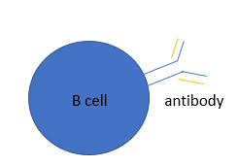
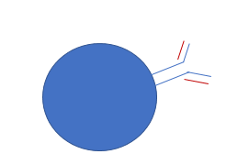
Antibody basics

Slide 11
Antibody basics
Virus
Activated B Cell

Slide 12
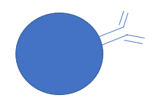
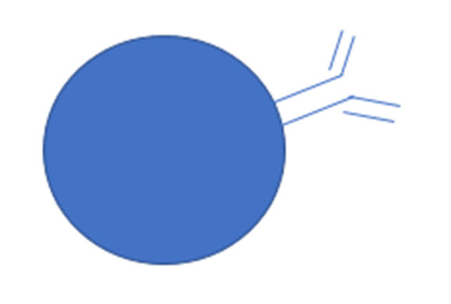
Antibodies IgM and IgG
-Bind virus
-Prevent it from entering cells
-Flag it to be eaten up
Memory Cells
-Ready to be
Re-activated next time
Plasma Cells
-Antibody factories

Slide 13
Types of Antibody Tests

Slide 14
Types of Antibody Tests
Type of test | Pros | Cons | What it cannot tell us
Rapid diagnostic test (RDT) “Home test” | Simple Fast (10-30 min) | May not be as accurate | The amount of antibodies, or if these antibodies are able to inhibit virus growth
Enzyme linked immunosorbent assay (ELISA) | More accurate Determines amount of antibodies 3-5 hrs | Requires more lab resources | If the antibodies are able to inhibit virus growth.
Chemiluminescent immunoassay | More accurate Determines amount of antibodies 1-2 hrs | Requires more lab resources. | If the antibodies are able to inhibit virus growth.

Slide 15
Biostatistics 101
The test isn’t always right

Slide 16
Biostatistics 101 - Definitions
You have a disease
False negative –you have the disease, but the test is negative
100 – false negative rate= “Sensitivity” of the test
A test that has 0 false negative results is “100% sensitive” for the disease
A test that has 10% false negatives is “90% sensitive” for the disease
Sensitivity = False negative

Slide 17
Biostatistics 101 - Definitions
You don’t have a disease
False positive – you DON’T have the disease, but the test is positive
100 – False positive rate = “Specificity” of the test
A test that has 0 false positive results is “100% specific” for a disease
A test that has 5% false positives is “95% specific” for a disease
Specificity = False positives

Slide 18
False positives – why does it matter
You are giving people false sense of safety when they are still at risk
If people then DO get sick, it creates a false narrative of people getting sick again after recovering
Overestimates the immunity in the population and underestimates further spread of the virus

Slide 19
False positives – why does it matter
The problem is magnified when it is early the outbreak and not a lot of people have the disease
And yes, it’s still early in the outbreak, and not a lot of people have the disease

Slide 20
A Problem to Show The Problem with False Positives

Slide 21
The Problem with False positives
HYPOTHETICAL EXAMPLE
Santa Fe County population 150,000
100 people in the county were diagnosed with the disease
5,000 other people in the county have had the disease but were not tested because they didn’t feel sick

Slide 22
False positives – hypothetical example
Let’s do antibody testing on 1% of the residents who were not sick get an idea of how many people might have already recovered!
1500 people
50 had disease
1450 did not have disease
The test has 10% false positives = 90% specific
The test has 2% false negatives = 98% sensitive

Slide 23
False positives – IS 10% GOOD ENOUGH?
 | Had Disease 50 people | No Disease 1450 people | Total Tested 1500 people
Test Positive | 49 | 145 | 194 positive tests | 145/194 = 75% of positive tests DIDN’T HAVE DISEASE!!!
Test Negative | 1 | 1305 | 1306 negative tests | 1305/1306 = 99.9% negative tests didn’t have disease

Slide 24
False positives – IS 10% GOOD ENOUGH?
145/194 = 75% of people who test positive did not have disease!
Health officials see 194/1500 = 13% of the survey group have had it
NO!!
50/1500 = 3% have had it
Is 90% specific good enough?

Slide 25
False positives – IS 2% GOOD ENOUGH?
 | Had Disease 50 people | No Disease 1450 people
Test Positive | 49 | 29 | 78 positive tests | 29/78 = 37% of positive tests DIDN’T HAVE DISEASE!!!
Test Negative | 1 | 1421 | 1422 negative tests | 1421/1422 = 99.9% negative tests didn’t have disease

Slide 26
False positives – IS 2% GOOD ENOUGH?
29/78 =37% of people who test positive did not have disease!
Health officials see 78/1500 = 5% of the survey group have had it
NO!!
50/1700 = 3% have had it
98% Specific is a whole lot better

Slide 27
In My Opinion…
10% false positives (90% specific) isn’t good enough
I’ll settle for 98% specific
WE NEED TO GET THIS RIGHT

Slide 28
FDA policy
https://www.fda.gov/news-events/fda-voices/insight-fdas-revised-policy-antibody-tests-prioritizing-access-and-accuracy
https://www.fda.gov/media/135659/download

Slide 29
FDA Policy
Updated May 4, 2020
Time limit for manufacturers to submit data to FDA
Defines thresholds for performance of tests (false positives/negatives)
Requires manufacturers to alert consumers about possibility of false results and steps to address this.

Slide 30
Status of tests in USA
https://www.centerforhealthsecurity.org/resources/COVID-19/serology/Serology-based-tests-for-COVID-19.html#sec4
May 1, 2020
7 FDA approved tests
34 approved tests for research and surveillance
15 tests in development
More than ½ the manufacturers have not provided their false positive and false negative rates
False positive rates vary from 0 to 10%

Slide 31
Direct to Consumer Antibody Testing
Quest diagnostics
Online screening questions
Go to a lab for blood draw
$119
Results posted securely online
What’s the specificity? How many false positive tests?
????

Slide 32
Direct to Consumer Antibody Testing
Quest diagnostics
“The IgG antibody serology test has not been reviewed by the FDA.”
“Results from antibody testing should not be used as the sole basis to diagnose or exclude SARS-CoV-2 infection or to inform infection status.”
“Positive results may be due to past or present infection with non-SARS-CoV-2 coronavirus strains, such as coronavirus HKU1, NL63, OC43, or 229E”
https://www.questdiagnostics.com/home/Covid-19/Patients/

Slide 33
Phrases to look for
“Specificity” --- ideally 98% or higher
“Negative percent agreement” – ideally 98% or higher
“False positive
“not to be used as a sole basis for diagnosis” – taking the manufacturer’s word for it…BUYER BEWARE
“Positive results may be due to…” -- alerts you to false positives

Slide 34
Antibody Surveillance Testing

Slide 35
Antibody Surveillance Testing
New York City– 21% (Specificity?? = false positive rate ??)
Southern California – 4.1% (99.5% specific = 0.5% false positives)
Northern California – 1.2 – 2.8% (Same test as above)
Chelsea (Boston) – 31.5% (90% specific = 10% false positives ouch!)
Robbio, Italy – 10% (??)
Gangelt, Germany – 14% (??)

Slide 36
The Bottom Line
Antibody surveillance testing in areas of COVID-19 outbreaks suggest 1 – 30% of people may have already been infected and recovered
At this stage, “false positive” test results can dramatically mislead individuals and policy makers
A lot of Direct-to-Consumer antibody tests will be marketed in the coming months.
Because of the emergency, tests are not being held to the usual FDA standards to ensure they are valid – it is up to the manufacturer
WE SHOULD INSIST ON THE MOST SPECIFIC TESTS POSSIBLE

Slide 37
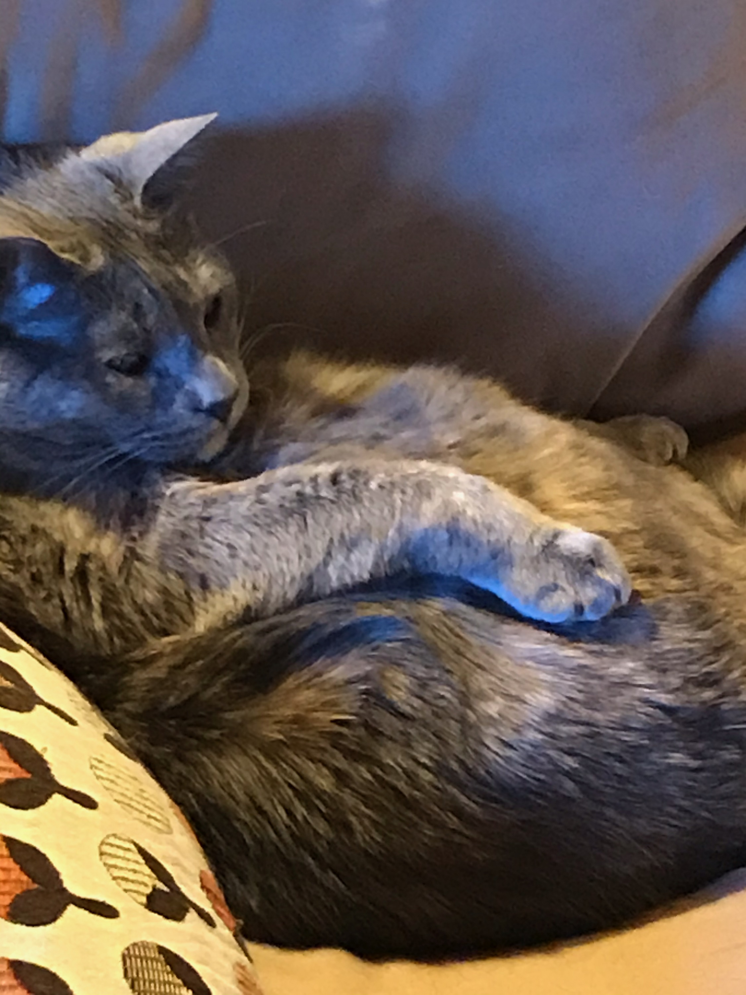
Thank you!
Amanda Lewis Janet Phillips Greg Shores Brittney VanDerWerff
Binge watch all the presentations here!
jsplibrary.org
facebook.com/jemezspringslibrary

Slide 38
References
1) Bendaved, E et.al., COVID-19 Antibody Seroprevalence in Santa Clara County, California pre-print doi: 10.1101/2020.04.14.2006246
2)http://www.publichealth.lacounty.gov/phcommon/public/media/mediapubhpdetail.cfm?prid=2328
3) https://www.nytimes.com/2020/04/23/nyregion/coronavirus-antibodies-test-ny.html
4) https://science.sciencemag.org/content/368/6489/350.full

